Slide 1
RECURRENT NEURAL NETWORK FOR SENTIMENTAL ANALYSIS
Recurrent Neural Networks(RNN) is a type of artificial neural network designed for processing sequences of data . In sentiment analysis, RNN can be highly effective because the goal is to classify the sentiments such as(positive , negative and neutral , etc.) of a given text . It involves understanding the emotional tone behind the words and Recurrent Neural network is particularly effective for handling sequential data's such as text , speech and time series data.

Slide 2
What is Recurrent Neural Network ?
Recurrent Neural Network is a type of Artificial neural network.
Designed for processing sequence of Data.
Particularly effective for Handling sequential data with varying lengths ,such as text, speech and the time series data.
Maintains a hidden state or memory(RNN are able to retain the memory of previous inputs in the sequence because of the connections that create cycles within the network.
What is Sentiment Analysis ?
It is the process of determining the emotional tone or sentiment expressed in a piece of texts (such as review or social media posts..) expresses a positive , Negative or Neutral sentiment.

Slide 3
The Aim of sentiment analysis is to classify text into categories that reflect the writer's feelings or opinions, typically as positive, negative, or neutral.
Example:-
Positive :- I love this necklace.
Negative :- I hate the necklace design.
Neutral :- The necklace design is okay ,but it could be better.
It aims to predict the sentiment behind a text.
Common use Cases of Sentiment Analysis :-
Product Reviews Social Media Monitoring Customer Feedback
Political Sentiment Brand Monitoring

Slide 4
Why use RNN in sentimental Analysis?
RNN have connections that generate cycles . Which can retain memory of previous words or time steps in the sequence . This memory is crucial in recognizing the sentiment in a sentence because the sentiment might depend on how words relate to each other in context.
Steps to Implement Sentiment Analysis with RNNs :-
Step 1:- Data Collection
Step 2:- Data Preprocessing
Tokenization
(Break texts into Words/Token)
Padding
(RNN require sequences of the same length ,padding is often applied to ensure uniform sequence length for all text)
Vectorization
(Convert the text into numerical format)

Slide 5
Step 3:- Build the RNN Model(RNN model for sentimental analysis includes)
Embedding Layer :- Converts words into dense vectors.
LSTM(Long Short-Term Memory) - Advanced RNN architecture that uses memory cells to store information over a long periods,to process these word vectors and learn sequential dependencies.
GRU(Gated Recurrent Unit) – a simplified version of LSTM , offering a balance between performance and complexity.
Dense layer :- Outputs the sentiment class(Positive ,negative or neutral).
Step 4:- Train the model
To train we use suitable loss function.
Binary–cross entropy for binary sentiment classification.
categorial cross entropy for multi-class classification.
Once the model is build ,we can train it using training data(x_train and y_train) for binary analysis , the labels(x_test and y_test will be 0 or1
Step 5:- Evaluation
Evaluate the model using accuracy, precision, recall and F1 score on a validation or test dataset.

Slide 6
Evaluation Metrics :-
Once model is trained ,we can use metrics such as,
Accuracy : Percentage of correct prediction
Precision/Recall/F1 Score :-Suitable for dealing imbalanced classes.
Confusion Matrix : To visualize false positives and False negatives.
Tools to implement RNN for Sentimental Analysis :-
TensorFlow - Powerful and Flexible framework for building and Training neural network.
PyTorch - Suited for research and prototyping
Keras - - A high-level API built on top of TensorFlow.
etc…..

Slide 7
Key advantages of RNN for Sentimental analysis :-
Contextual Understanding: RNNs can capture the context of words within a sentence, which is crucial for sentiment analysis.
Handling Variable-Length Sequences: RNN can process text sequences of varying lengths, making them flexible for real-world applications.
Learning Complex Patterns: RNNs can learn complex patterns and relationships between words and phrases, and improve the accuracy of sentiment analysis.
For example, negation words like "not," "never," or "no" can flip the sentiment of a phrase, and RNNs can learn how these complex relationships affect the sentiment.
Contextualized Sentiment Understanding: In sentiment analysis word meaning can change based on the context. RNN are capable of processing the entire sequence of words and understanding the relationship between words ,allowing them to take context better than simpler models. For example: great is a positive word but a negative statement (“The climate is great ,but the traffic was awful) Etc….

Slide 8
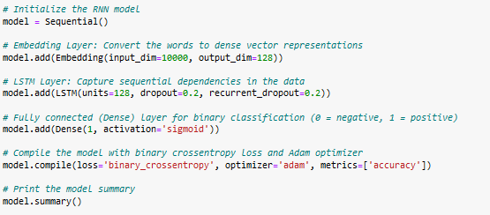
STEPS TO CODE :-
1. Import libraries
2. Load the dataset
3. Process the text data
4. Split the data into training and testing sets.
5. Build the RNN model.

Slide 9

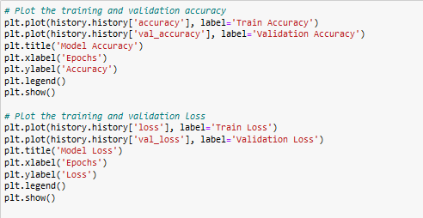
6. Train the model.
7. Evaluate the model
8. Plot the training and validation accuracy.
9. Make the predictions.

Slide 10
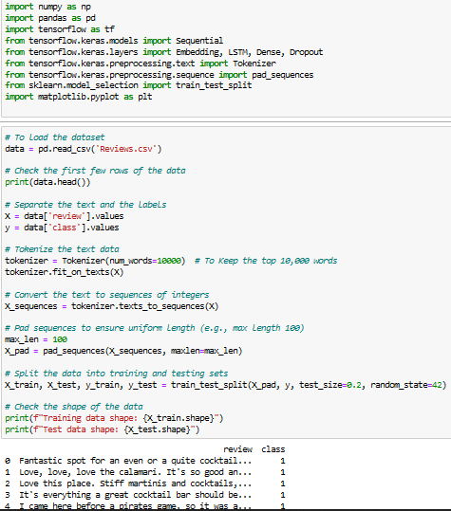
Full code

Slide 11
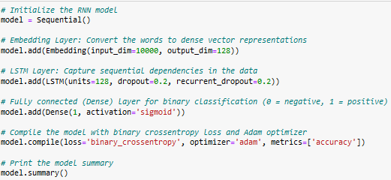
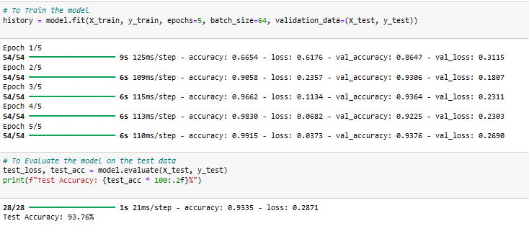

Slide 12
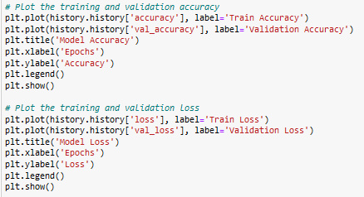
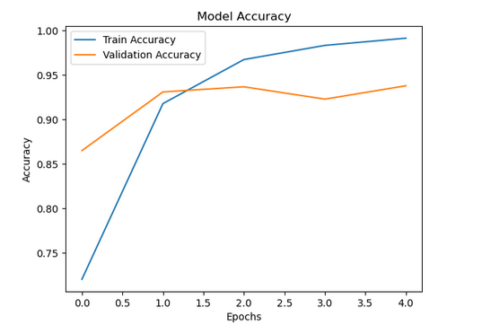
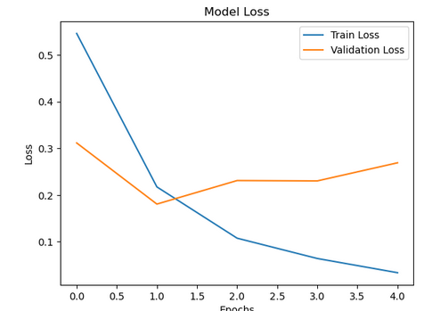
output

Slide 13
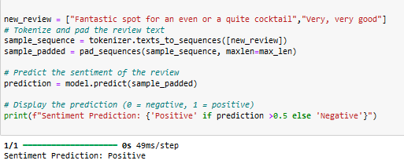

Slide 14
Link to Git hub
https://github.com/Hemabindhukrishnan/machine_learning.git
or
https://github.com/Hemabindhukrishnan/machine_learning/blob/714fe53b2760e54ab925e038989689b261bcda85/machine_lear_code.ipynb

Slide 15
Conclusion :-
Recurrent Neural Networks (RNNs), especially Long Short-Term Memory (LSTM) networks, are powerful tools for tasks involving sequential data, such as sentiment analysis . By capturing temporal dependencies, RNNs effectively handle complex patterns in text and numerical data. LSTMs, with their ability to overcome the vanishing gradient problem, excel in learning long-term relationships, making them ideal for applications like sentiment classification.

Slide 16
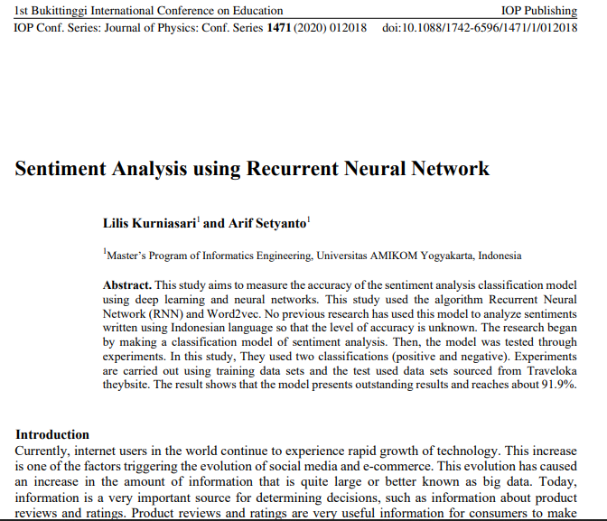
REFERENCES
1. https://iopscience.iop.org/article/10.1088/1742-6596/1471/1/012018/meta
Journal of Physics: Conference Series, Volume 1471, 1st Bukittinggi International Conference on Education 17-18 October 2019, West Sumatera, Indonesia

Slide 17
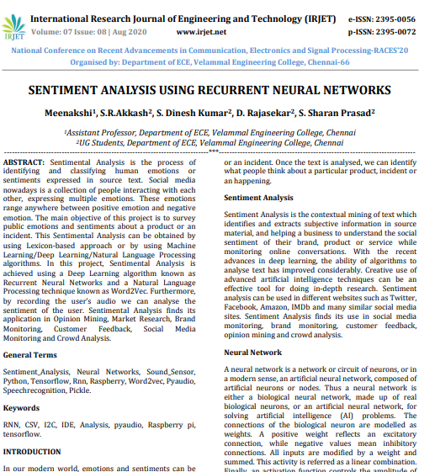
2. https://www.irjet.net/archives/V7/i8/Velammal/NCRACES-41.pdf

